Slide 1

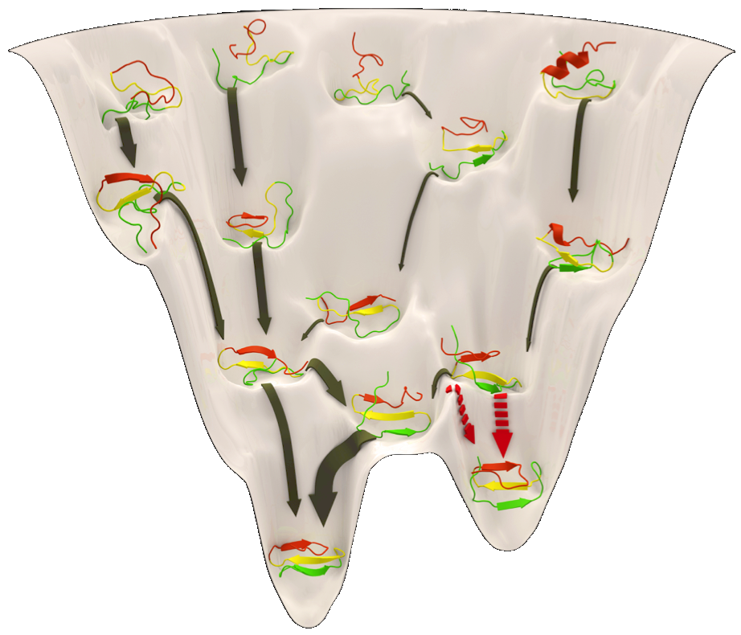
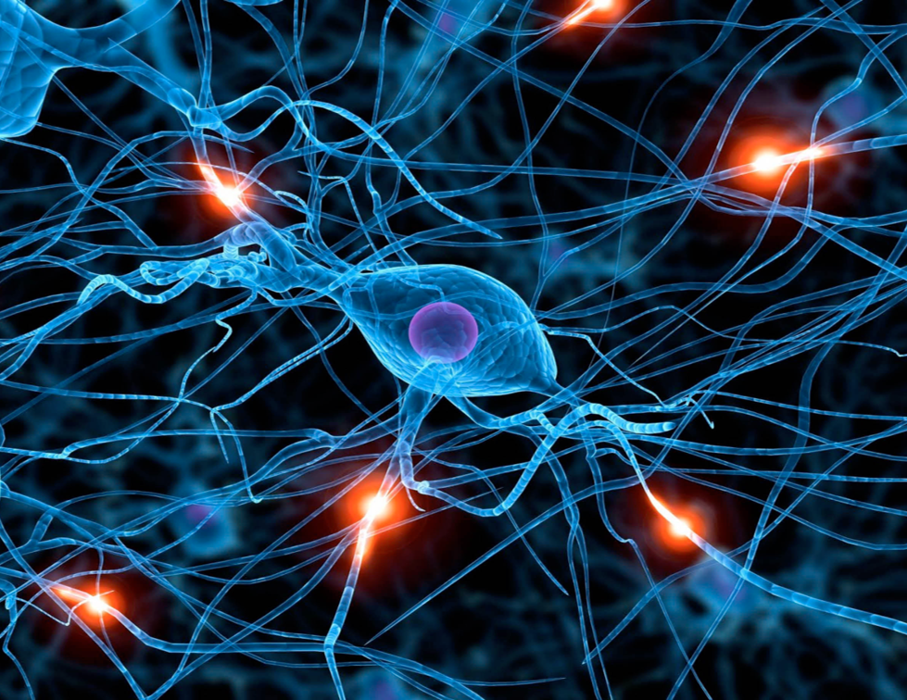
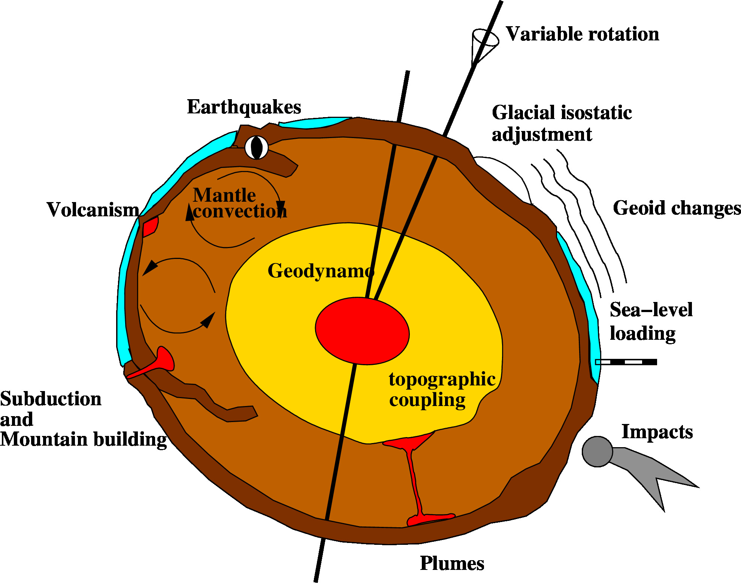
Computational Sciences
Notes:
1

Slide 2
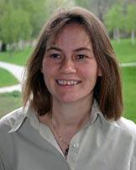
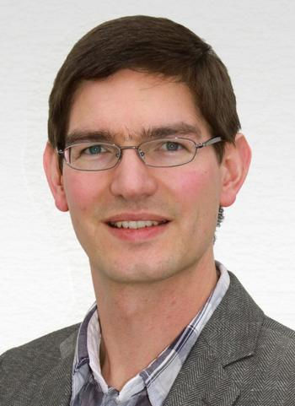
Committees and contact
Joint Commission (gemeinsame Kommission, GK):
Deliberates board decisions concerning the program
Examination Board (Prüfungsausschuss, PA)
Admission, approval of credit points, examination-related stuff
Education and Training Committee (Ausbildungskommission)
Mainly led by students
Currently slightly underrepresented ...
Program Office (Studiengangskoordination)
Support of both students and lecturers
Coordination, organization
Examination Office (Prüfungsbüro)
Module registrations, recognitions, thesis registration, …
https://www.imp.fu-berlin.de/fbv/pruefungsbuero/index.html
Student Initiative (Fachschaftsinitiative)
Student activities, networks, and student representation
https://fsi.spline.de/compsci/about-us/
Notes:
2

Slide 3
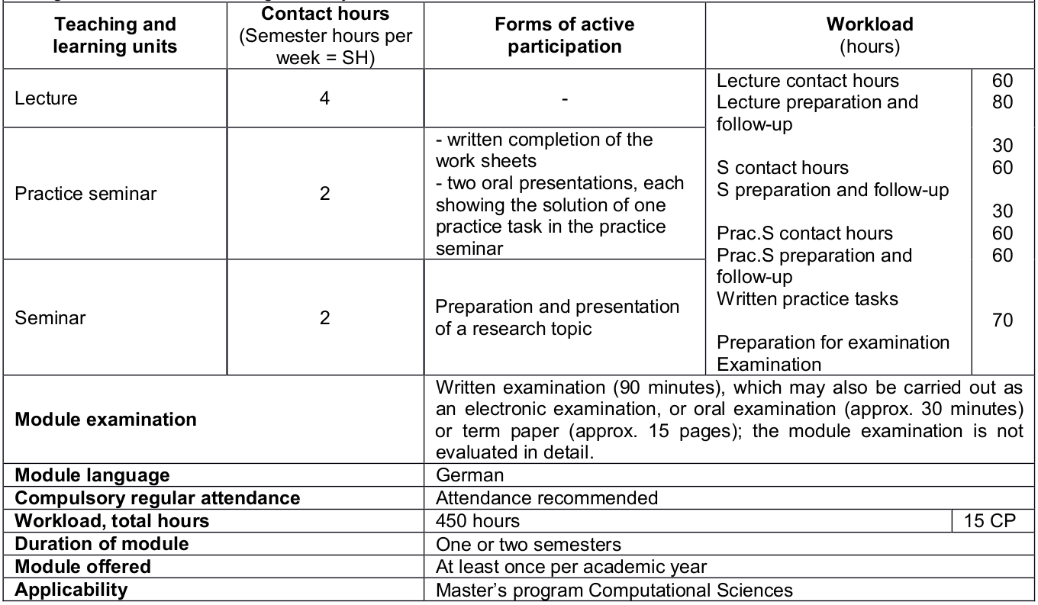
Program overview: Modules
Module: combination of 1to n courses, e.g.,
lecture + exercise
lecture + (project)seminar
lecture + exercise + seminar
research project in a work group
Lecture + exercise + lecture + exercise
…
Credits are awarded for the complete module
Register for Computational Sciences modules via Campus Management!
Notes:
3

Slide 4
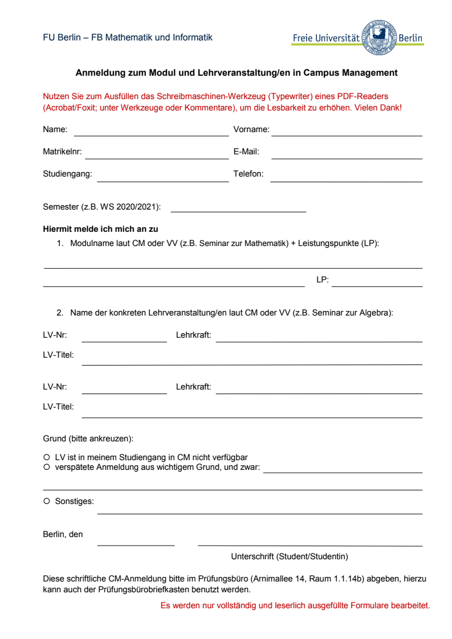
Program overview: Modules
A course (seminar, lecture, etc.) may be part of several modules, but only counts for one module
No module can be taken twice
Modules not in campus management should be registered through the registration form at the start of the term (fill out & submit to the examination office)
Modules completed earlier may be recognized toward the degree (contact the study coordinator for details)
Notes:
4

Slide 5
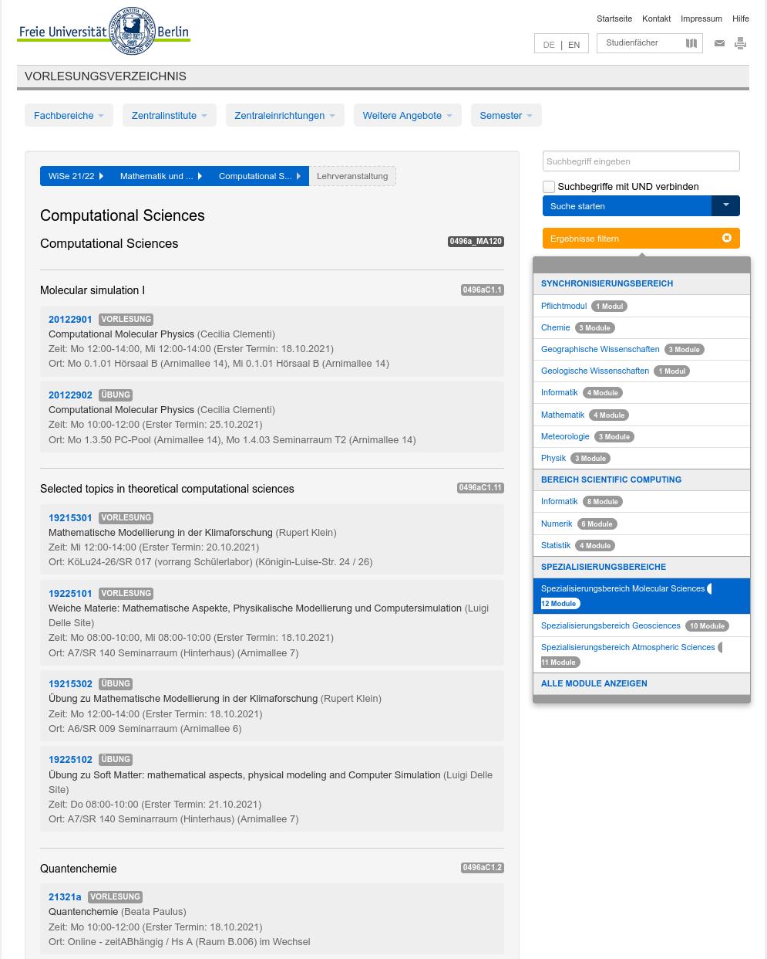
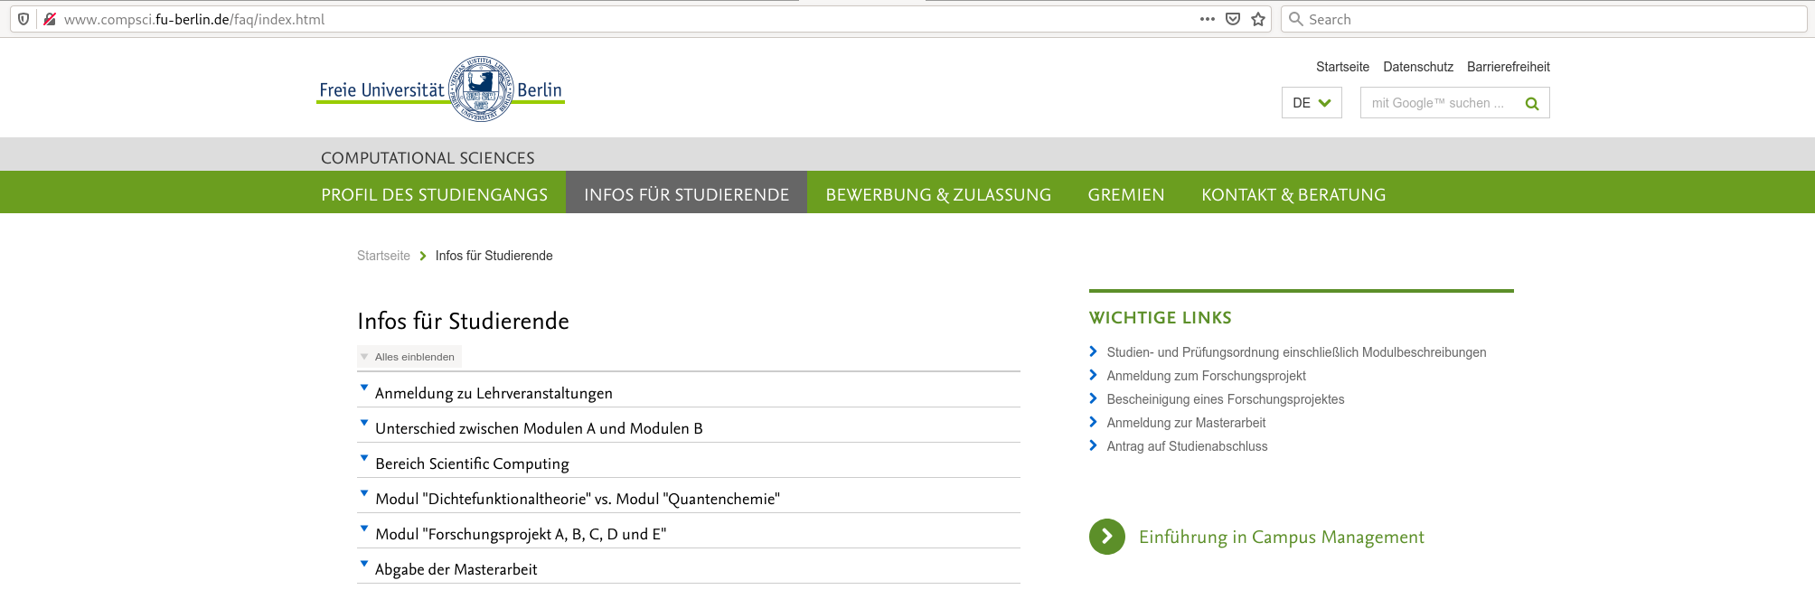
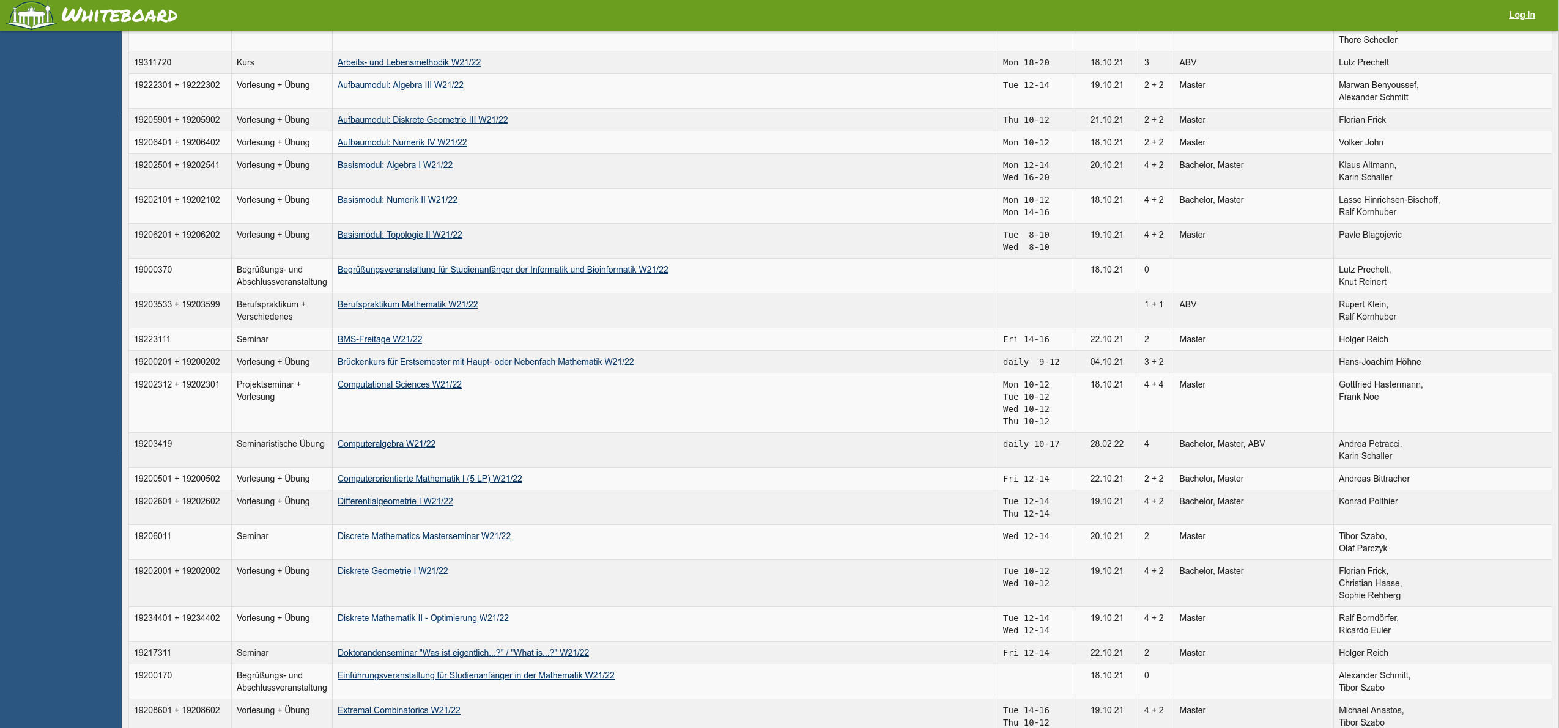
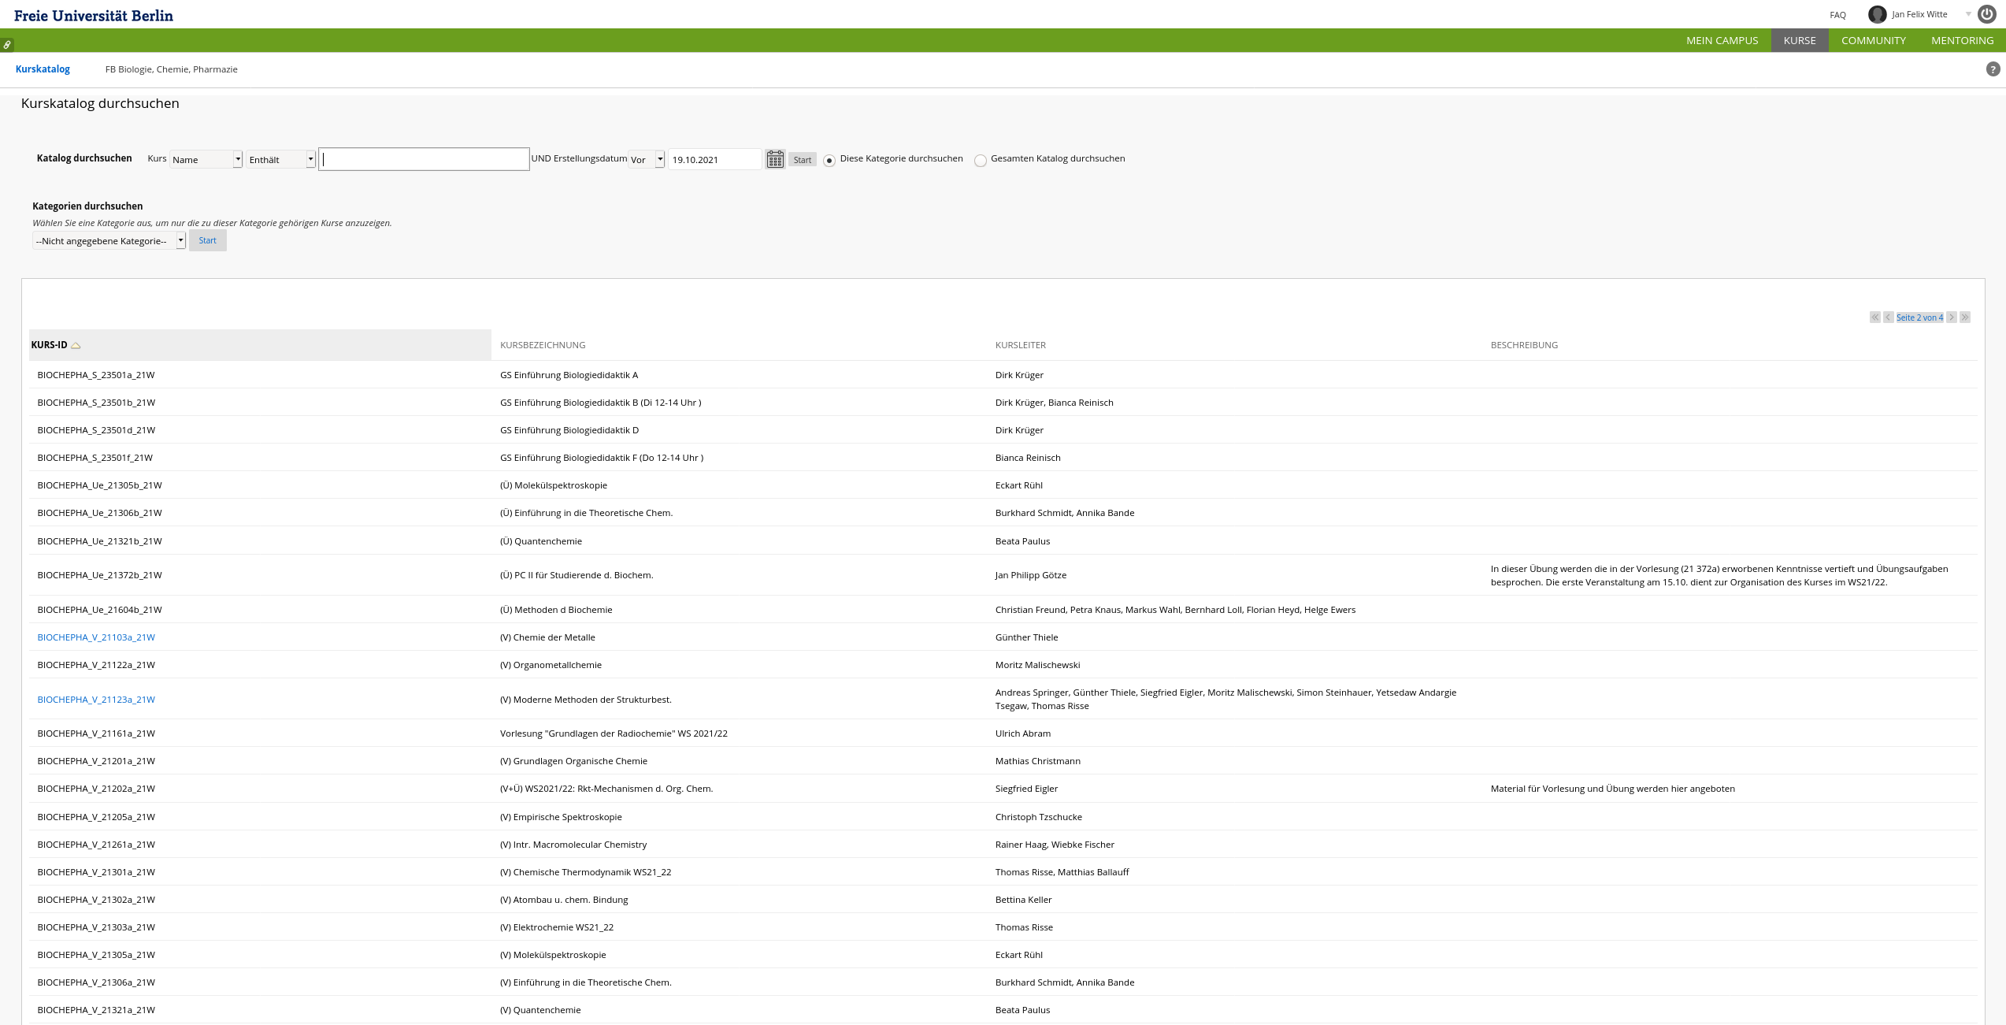
Programme overview: Websites
Course catalogue (VVZ): overview of courses offered for the degree and beyond
Computational Sciences Website: News, Events, Links to forms and FAQs
Whiteboard/MyCampus: course contents (maths, physics, computer science)
Blackboard: course contents (chemistry)
Notes:
5

Slide 6
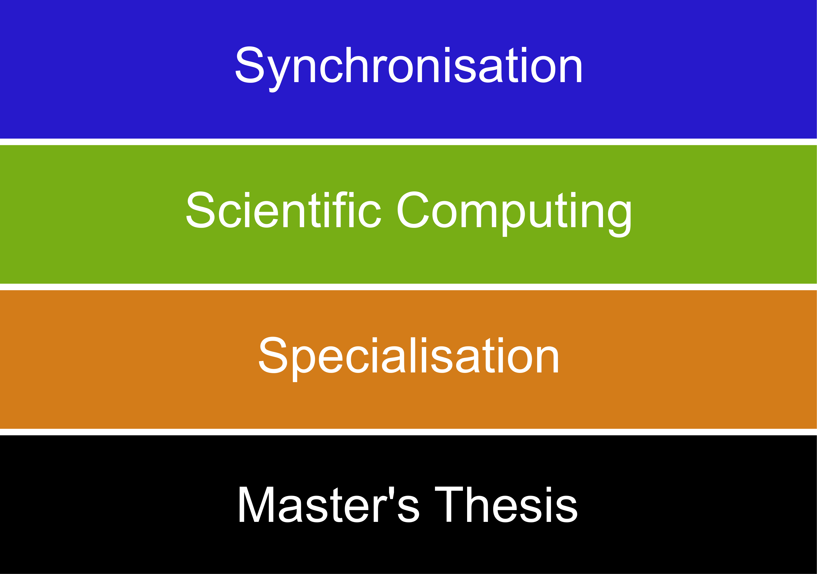
Programme overview: Areas
each contributes 30 credit points!
Notes:
6

Slide 7
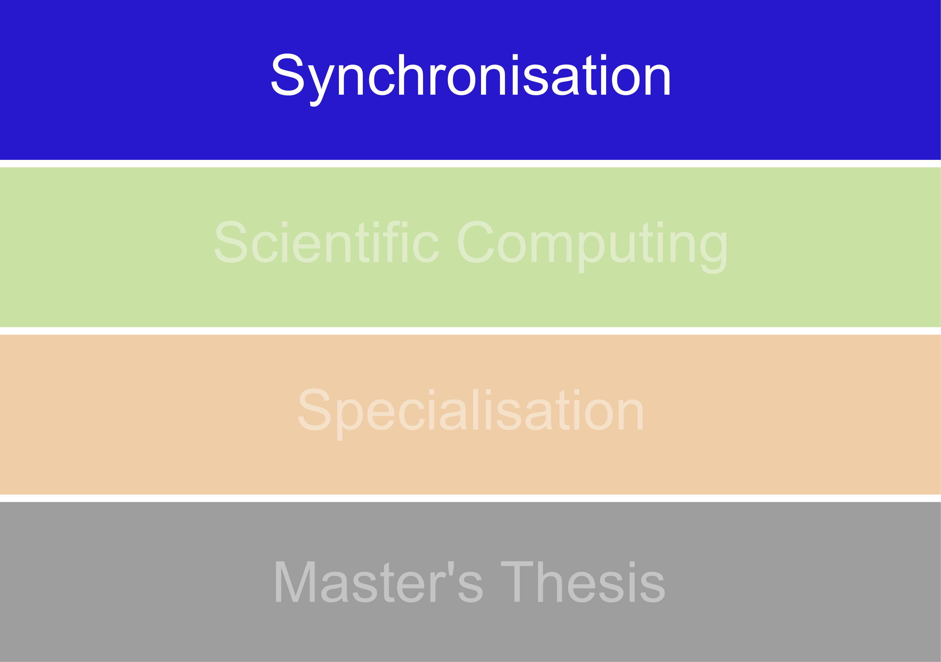
Synchronisation (30 LP)
Mandatory Module: Computational Sciences (15 LP)
  4h lecture: theory from multiple disciplines, mathematical methods, computational aspects, …
  4h project: implementation, testing, optimisation of lecture-related problems
  graded
Subject Synchronization (15 LP)
  Subject related to Bachelor’s degree (see study regulations)
  Aims to equip students with “missing” qualifications (i.e. maths & computer science for natural sciences students, natural science for computer science & math students)
  Not graded, simply “passed” or “not passed”
  Some courses (from Bachelor programs) taught in German
Notes:
7

Slide 8
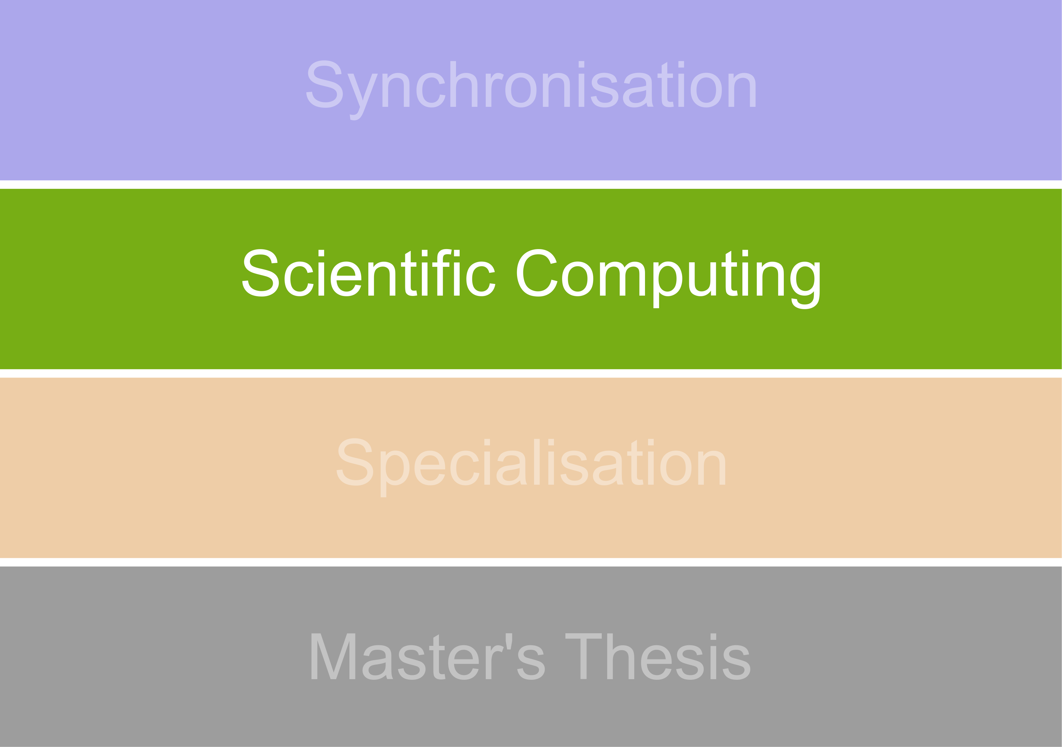
Scientific Computing (30 LP)
Subjects: Statistics, Numerics, Computer Science
Modules consist of lecture + exercise + seminar
One seminar may be part of multiple modules
Two module types: A (not graded), B (graded), pick one of each
One module examination!
Some modules are also offered as part of the synchronization – it is not possible to do the same module twice
Notes:
8

Slide 9
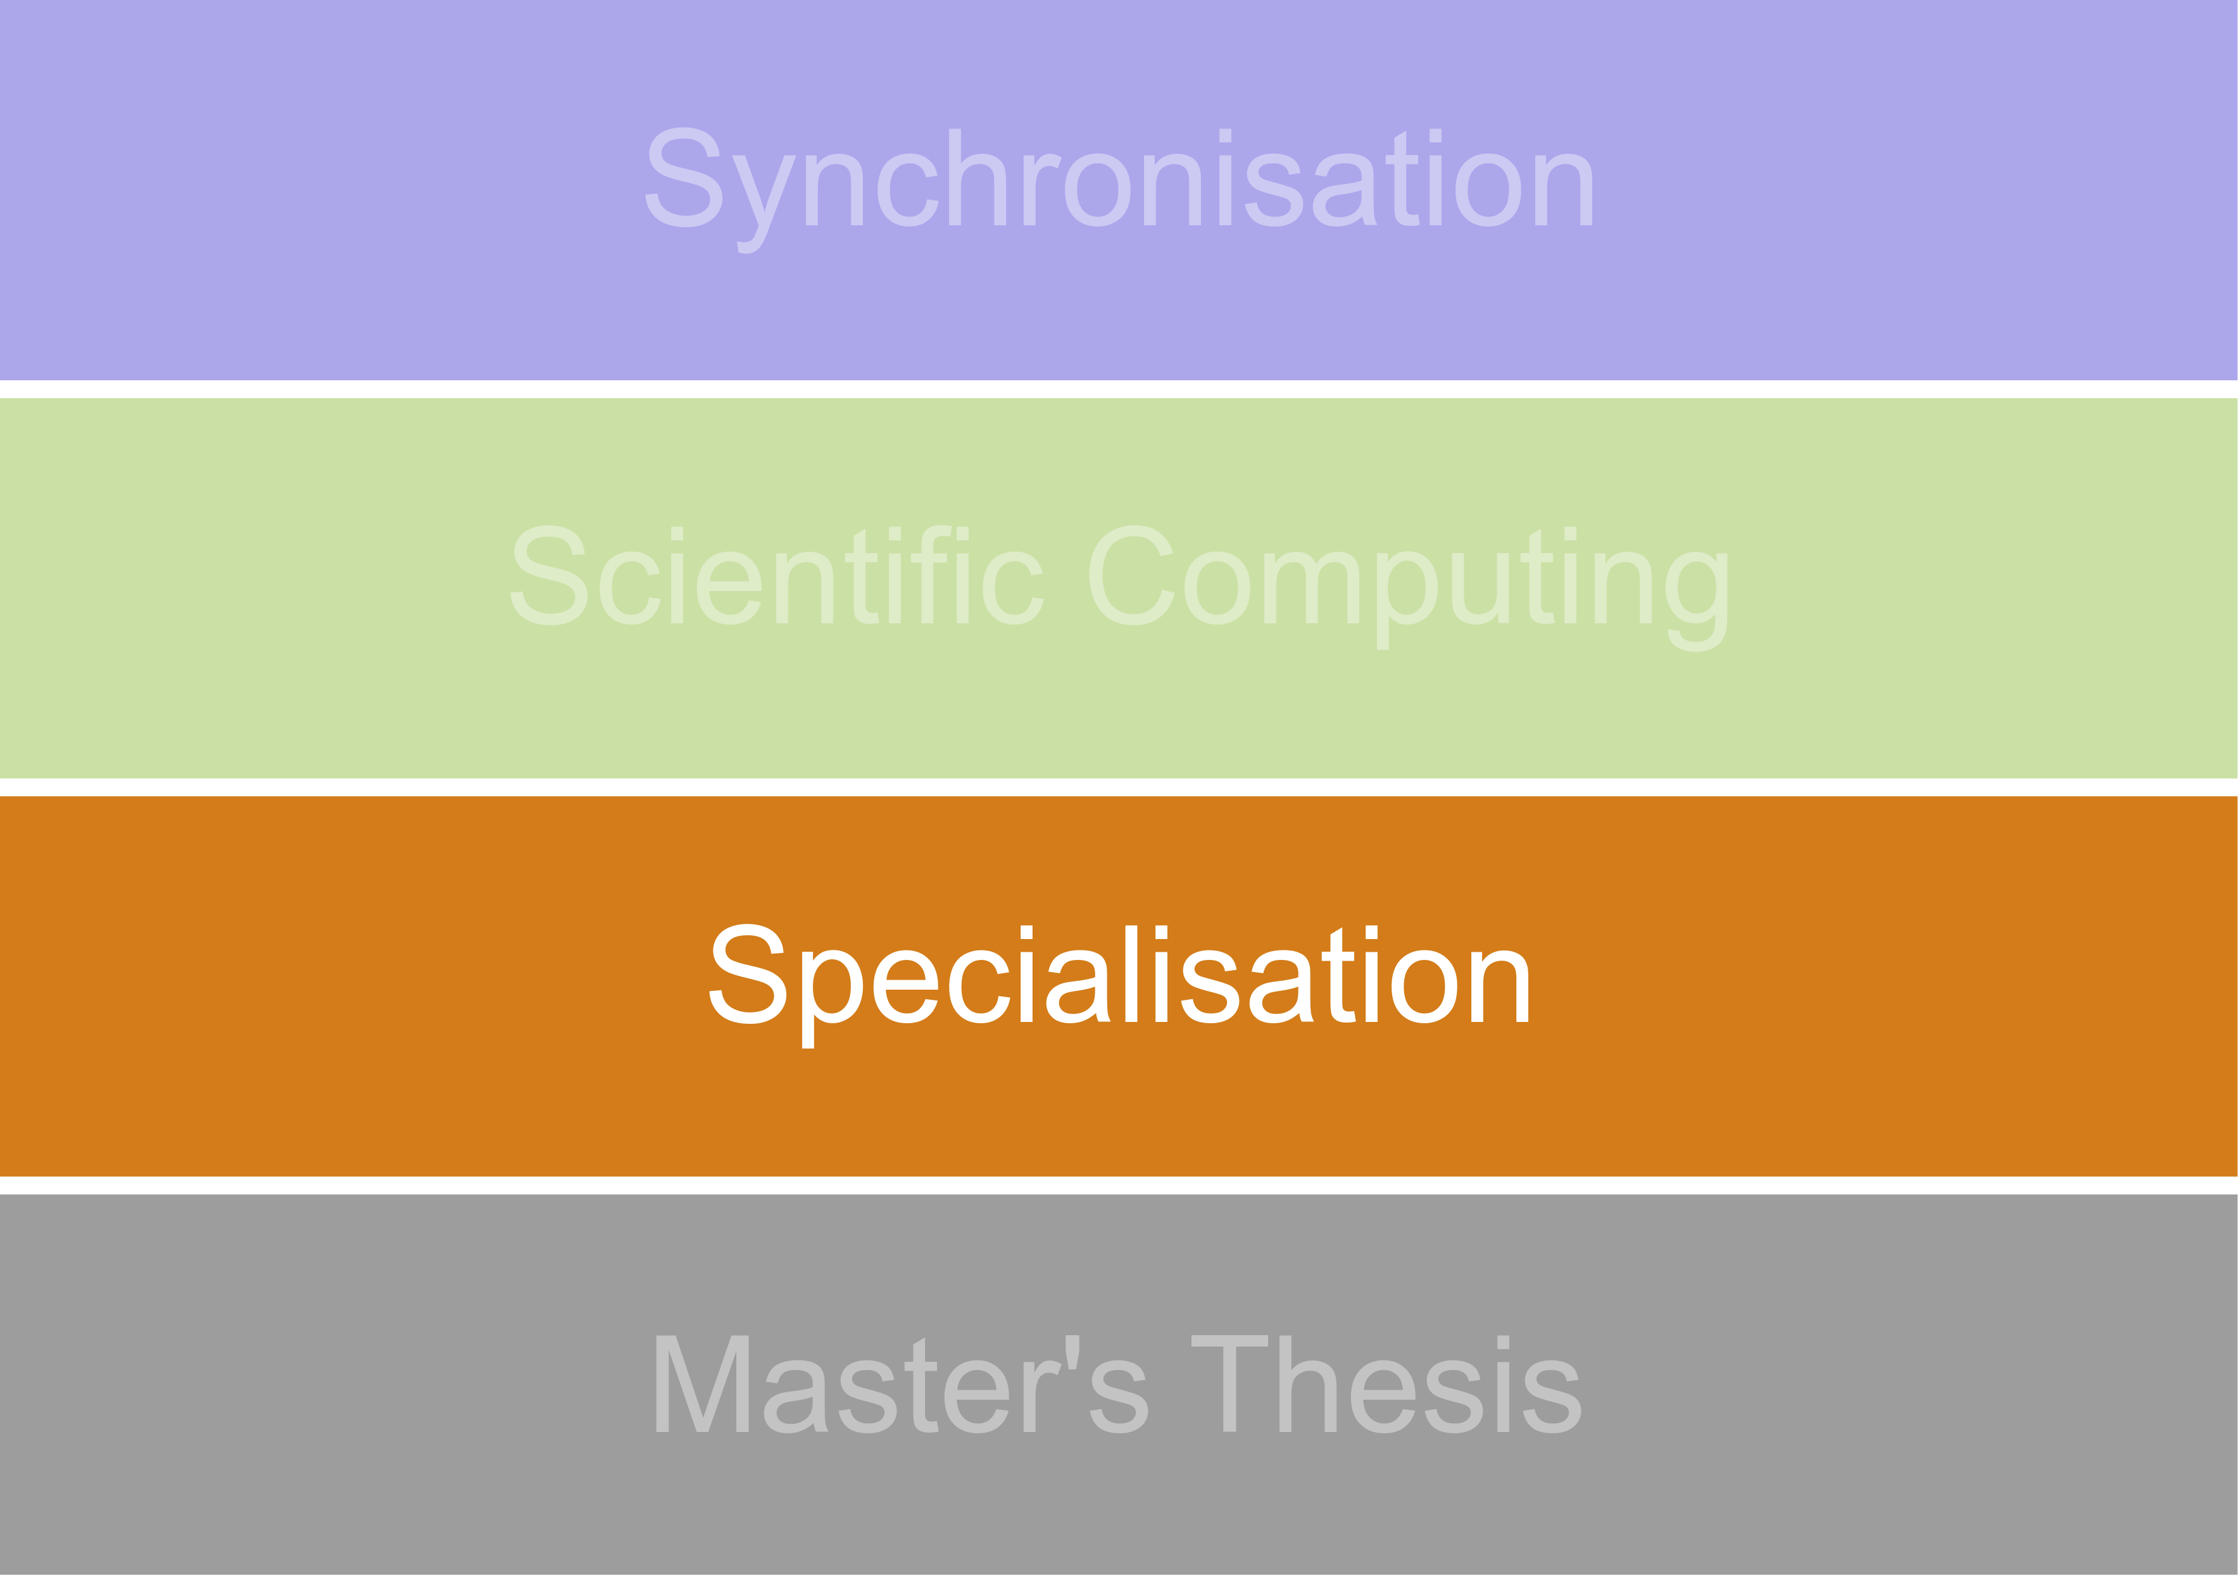
Specialisation (30 LP)
Molecular Sciences
Geosciences
Atmospheric Sciences
Choose your area of specialisation by the start of the 2nd semester!
Notes:
9

Slide 10
Molecular Sciences
a) Section A (5 – 10 LP)
Module: Foundations of Molecular Simulation 5 LP)
Module: Advanced Molecular Simulation (5 LP)
Module: Advanced Computational Physics (10 LP)
b) Section B (5 – 10 LP):
Module: Density Functional Theory (5 LP)
Quantum Chemistry (5 LP)
c) Section C (5 – 10 LP)
Module: Scientific Project A (5 LP)
Module: Scientific Project E (10 LP)
d) Section D (0 – 15 LP)
Module: Markov Modeling (5 LP)
Module: Quantum Chemical Correlation Methods (5 LP)
Module: Quantum Reaction Dynamics (5 LP)
Module: Elektronenstrukturmethoden (5 LP)
Module: Quantum Information Theory (5 LP)
Module: Advances in computational sciences (5 LP)
Module: Selected topics in applied computational sciences (5 LP)
Module: Selected topics in theoretical computational sciences (5 LP)
It is advised to choose “Computational Statistical Physics” in the Scientific Computing area to prepare for this specialisation (esp. Molecular Simulation)
Notes:
10

Slide 11
Geosciences
a) Section A (6 – 12 LP):
Module: MSc-GP002: Physik der Erde I: Physik der Erde (6 LP)
Module: MSc-GP006: Seismik II: Theorie seismischer Wellen (6 LP)
b) Section B (6 – 12 LP):
Module: MSc-GP003: Physik der Erde II: Eiszeiten als geodynamisches Werkzeug (6 LP)
Module: MSc-GP007: Seismik III: Inversions- und Abbildungsverfahren in der Geophysik (6 LP)
c) Section C (6 – 7 LP):
Module: Scientific Project B (6 LP)
Module: Scientific Project C (7 LP)
d) Section D (0 – 12 LP):
Module: MSc-GG006: Dynamik der Erde (6 LP)
Module: MSc-GG002: Thermodynamics und Kinetics of Geological Processes (6 CP)
Module: Geophysical modelling of planets and moons (5 LP)
Module: Advances in computational sciences (5 LP)
Module: Selected topics in applied computational sciences (5 LP)
Module: Selected topics in theoretical computational sciences (5 LP
Notes:
11

Slide 12
Atmospheric Sciences
a) Section A (8 – 16 LP)
Module: Weather and Climate Diagnosis (8 LP)
Module: Climate Variability and Climate Models (8 LP)
Module: Models for Weather and the Environment (8 LP)
b) Section B (6 – 9 LP)
Module: Scientific Project B (6 LP)
Module: Scientific Project D (9 LP)
c) Section C (5 – 16 LP)
Module: Satellite Meteorology (8 CP)
Module: Theoretical Meteorology I (8 CP)
Module: Theoretical Meteorology II (8 CP)
Module: Advances in computational sciences (5 LP)
Module: Selected topics in applied computational sciences (5 LP)
Module: Selected topics in theoretical computational sciences (5 LP
Notes:
12

Slide 13
The scientific project
Mandatory
Types: A, B, C, D, E
Reflect varying degree of effort and time: each specialization may pick a smaller or larger project
Content: Application of knowledge and acquired skills to a scientific (computation) problem
Usually (but not necessarily) completed within an associated work group of the Computational Sciences Master’s program
Hands-on work + research report + possibly seminar presentation
Preparation (or “test run”) for the Master thesis
Usually not in the course catalogue: find a project + supervisor & register via form at the examination office
Notes:
13

Slide 14
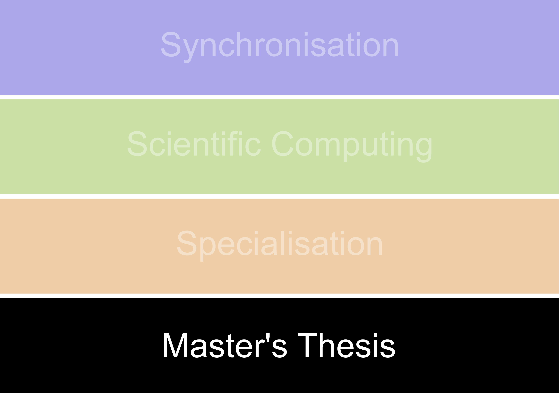
Master’s thesis
Supervised by a work group leader associated with the Computational Sciences Master’s program
Admission requirement:
Synchronisation area completed + 60 CPs acquired in total
30 – 80 pages, should be in English
30 min presentation
Registration: https://www.imp.fu-berlin.de/fbv/pruefungsbuero/Formulare/PDFs/Anmeldung-zur-Masterarbeit-_StOPO-2016_496a.pdf
Notes:
14

Slide 15
Sample programme schedule
1st semester
2nd semester
3rd semester
4th semester
Synchronisation
(Comp. Sci. 15 CP)
Scientific Computing B
(15 CP)
Specialisation (30 CP)
Master’s thesis
(30 CP)
Scientific Computing A
(15 CP)
Synchronisation
(15 CP)
Overlap possible, especially in the Computer Sciences area
Notes:
15

